Slide 1




Slide 2

Presented By
•Eslam Ibrahim Badr
•Abdelmonem Ali Elmongy
•Rawan Emad Elghali
•Mennatullah Mohamed Bahaa Eldein
•Yomna Hamed Shehabeldien

Slide 3

Content
01
Introduction
02
ERD & Mapping
Table of Contents
03
DataBase
04
SSRS
05
Website
06
Powe BI Dashboard

Slide 4


Examination System is an educational institution provides :
Dashboards for supervisors and managers to analyze student data, instructor performance, and more.
It provides guidance for professors to evaluate exams and offer valuable feedback.

Slide 5
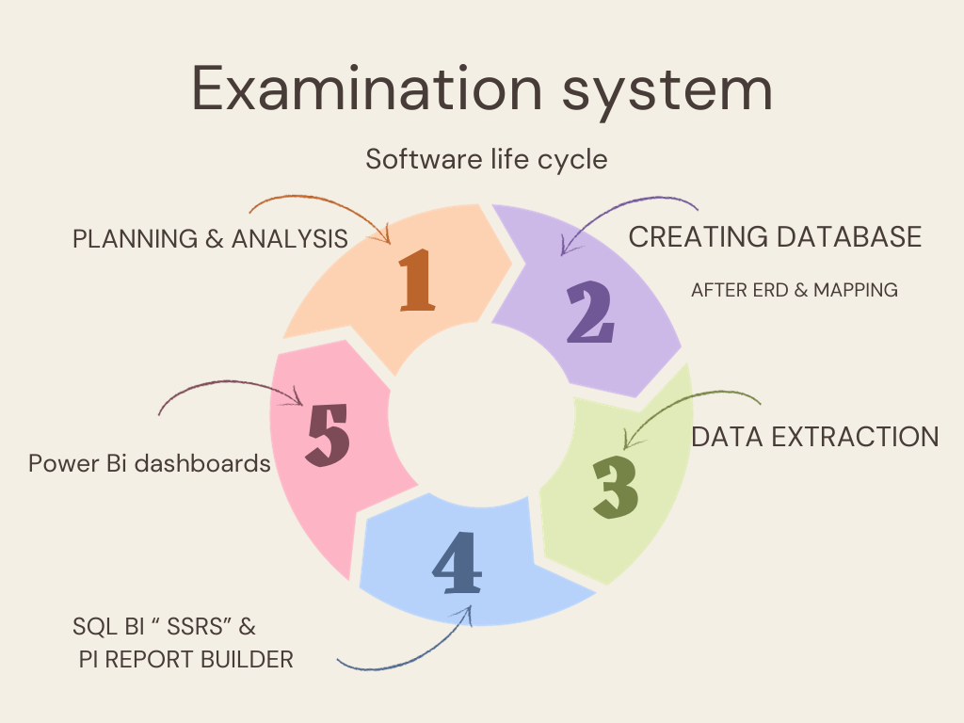
Tools
Microsoft Excel.
SQL BI (SSIS, SSRS)
Microsoft SQL server.
Power bi

Slide 6
ERD

Slide 7
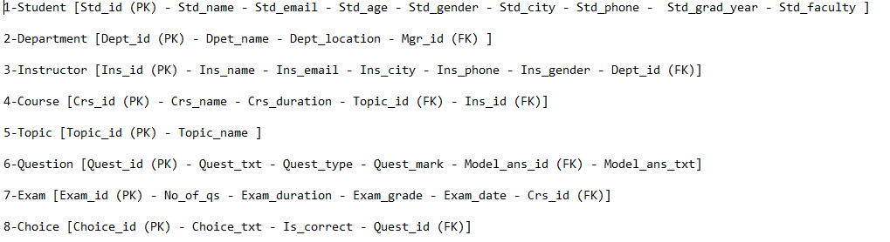
Mapping

Slide 8
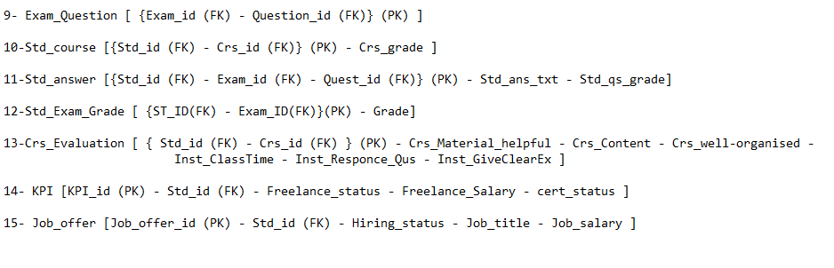
Mapping

Slide 9

Database
Database Creation
Stored procedures
Select ,Insert update and delete in any table
Exam generation
Exam Answers
Exam Correction & Grades

Slide 10
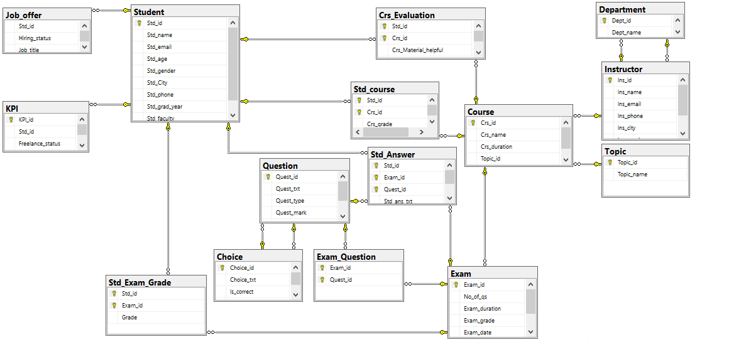
Diagram

Slide 11

Reports

Slide 12
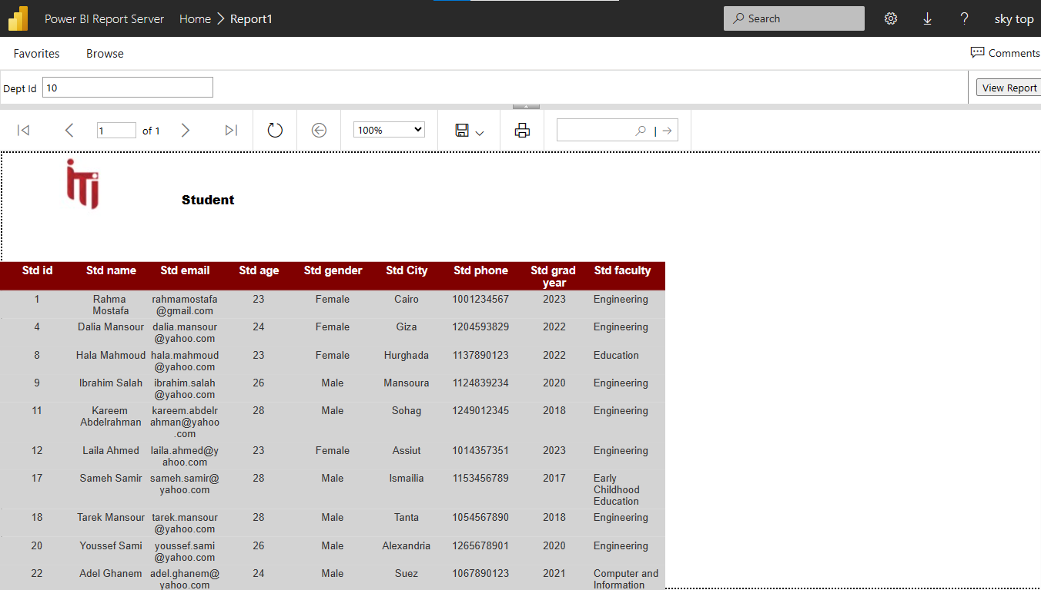
SSRS

Slide 13
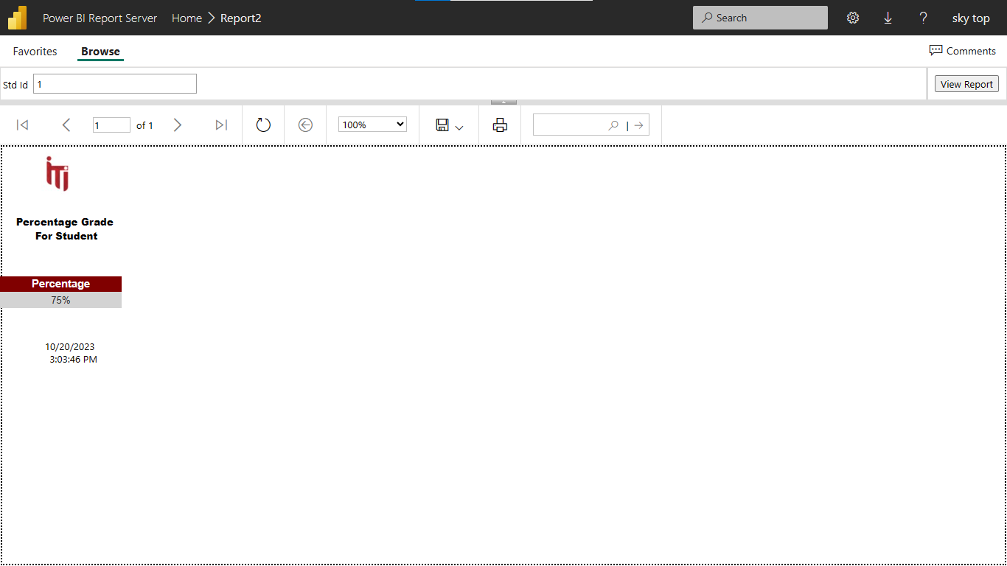
SSRS

Slide 14
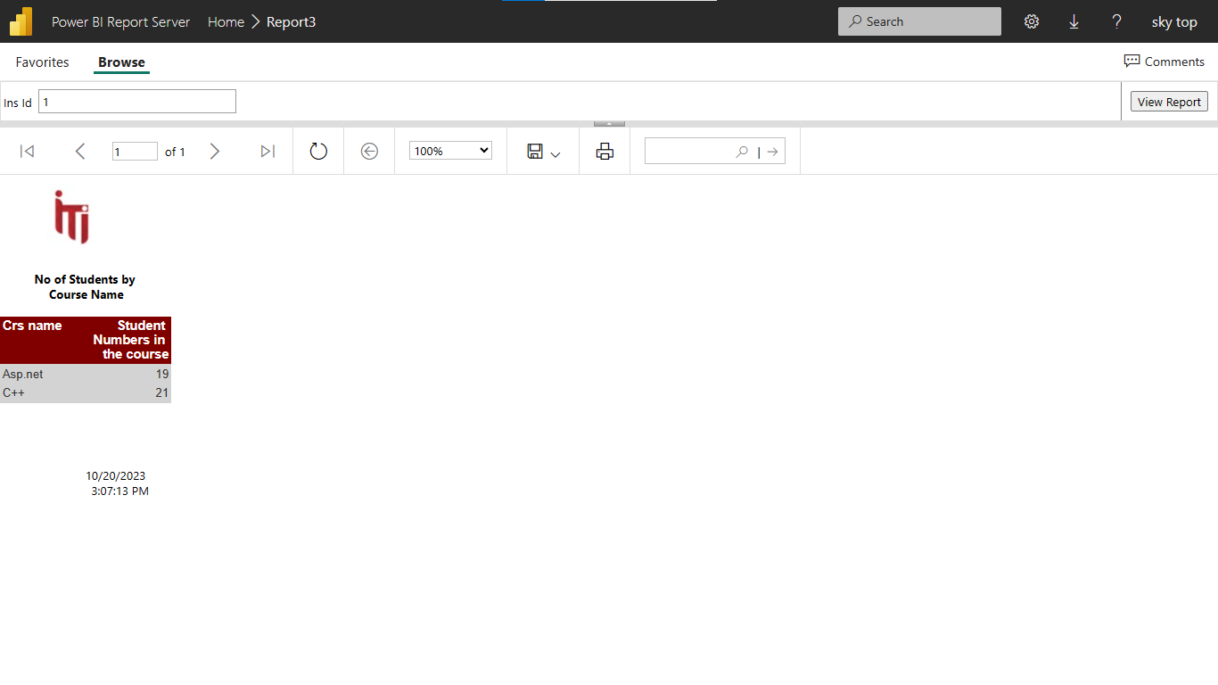
SSRS

Slide 15
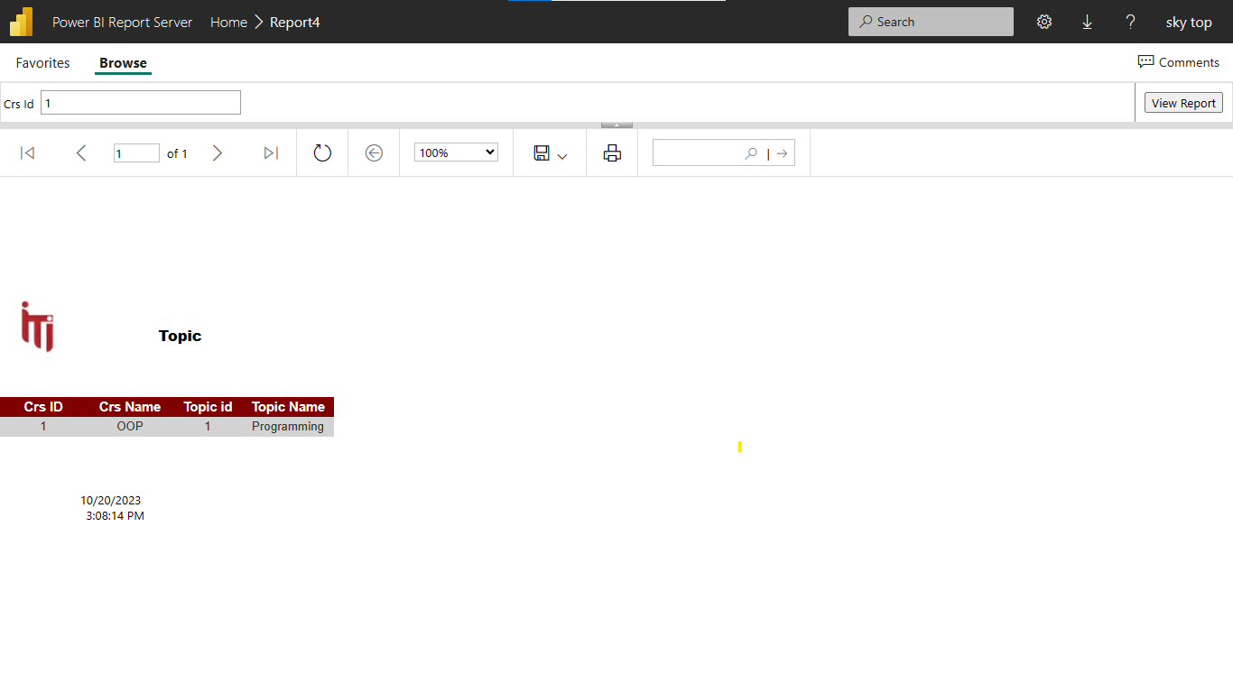
SSRS

Slide 16
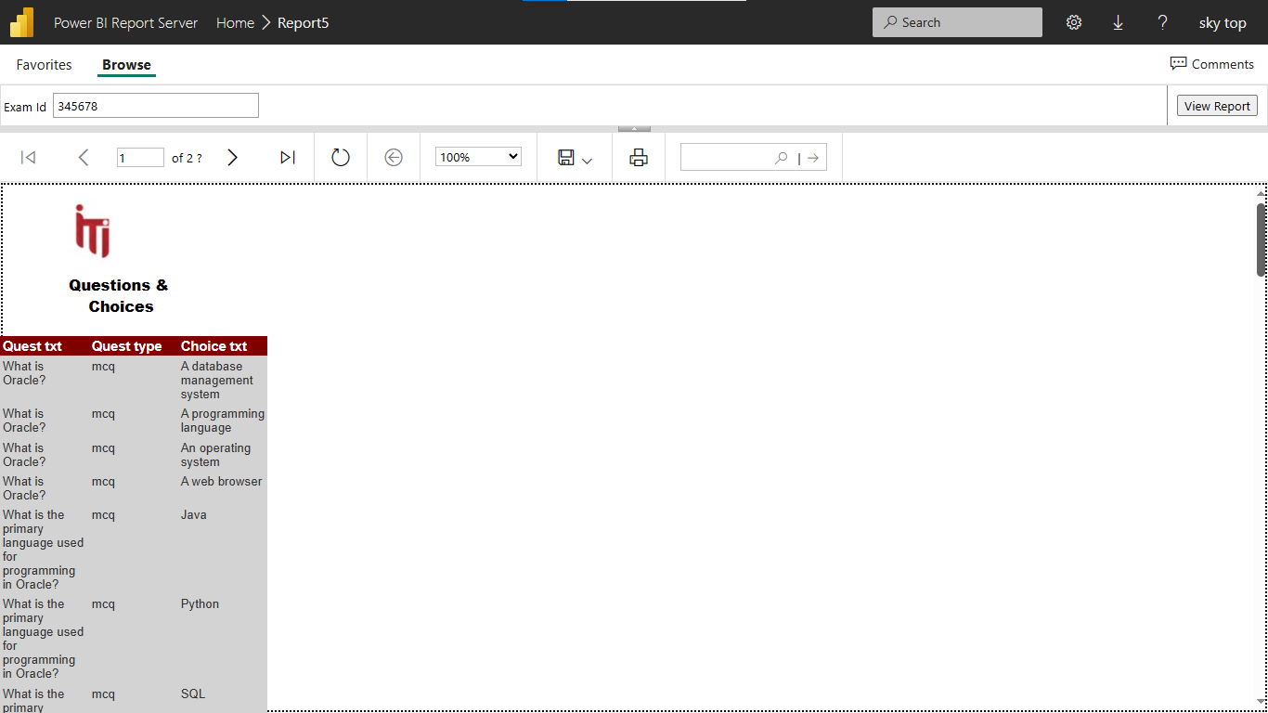
SSRS

Slide 17
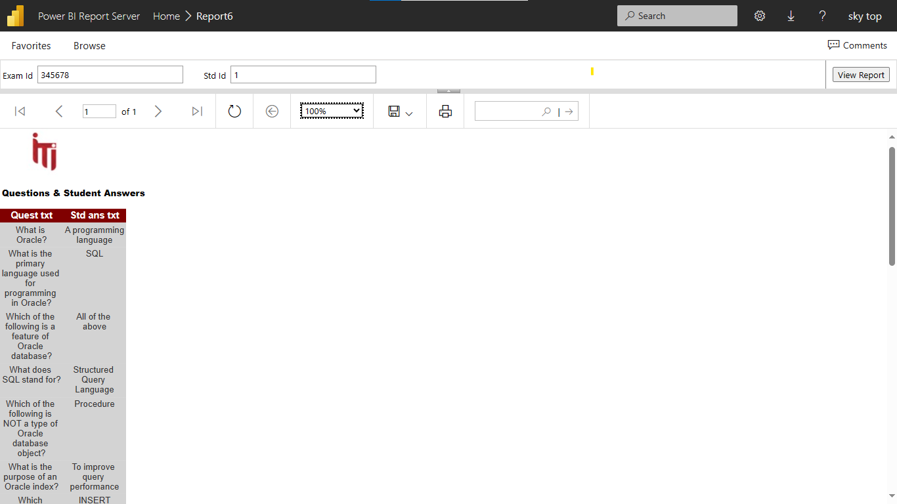
SSRS

Slide 18

Website

Slide 19
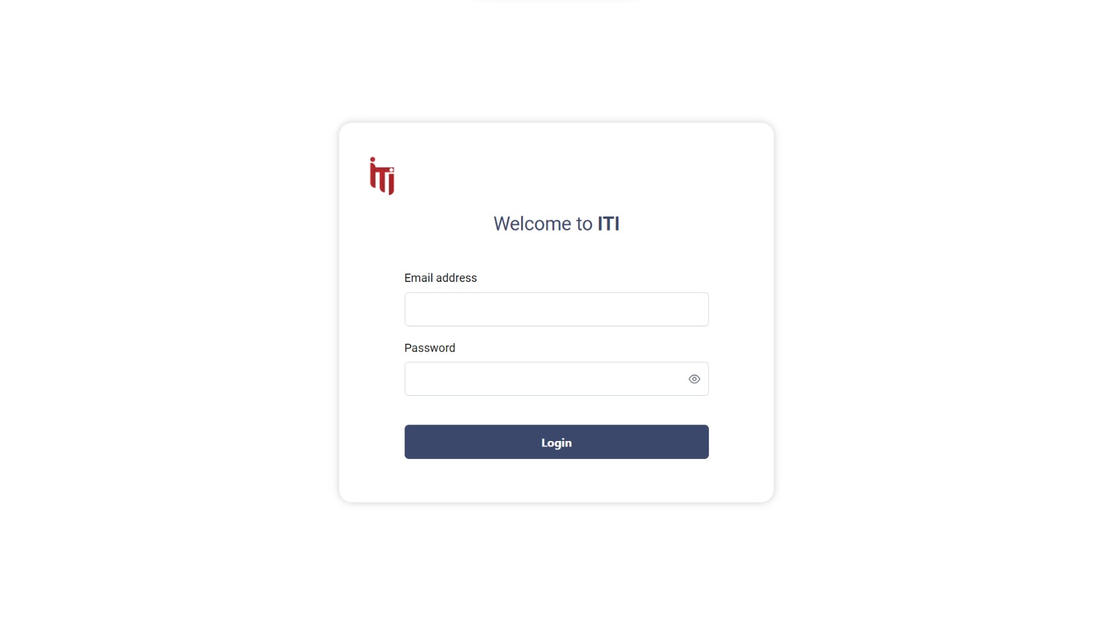
Website

Slide 20
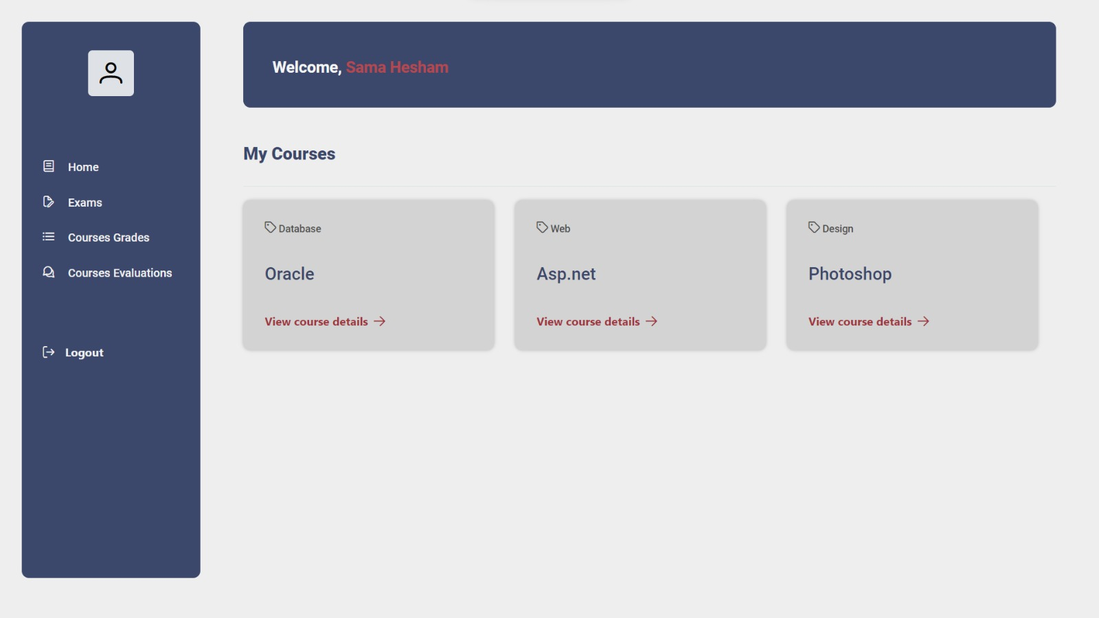

Slide 21
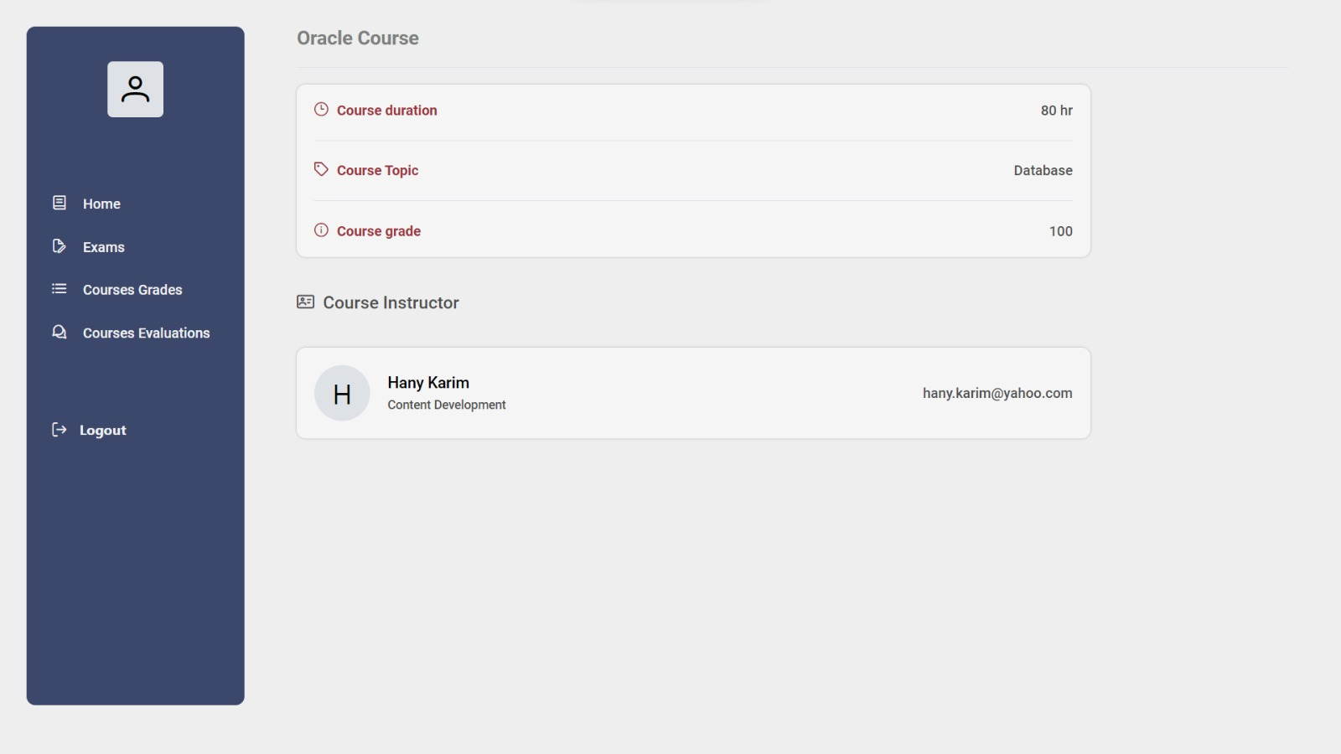

Slide 22
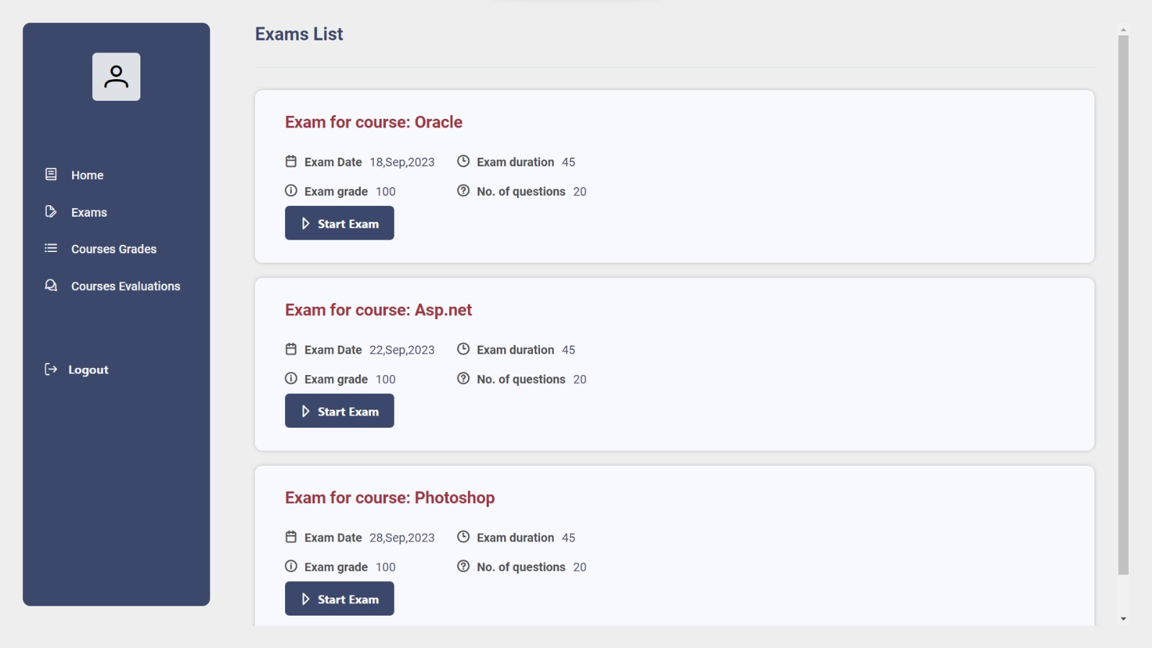

Slide 23
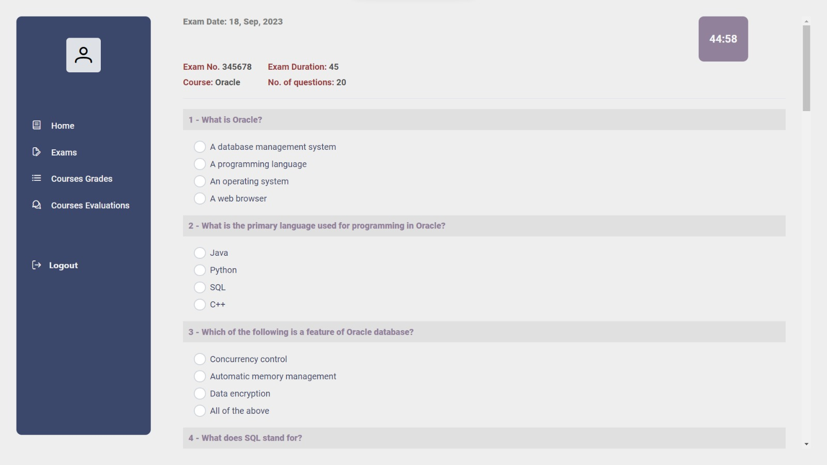

Slide 24
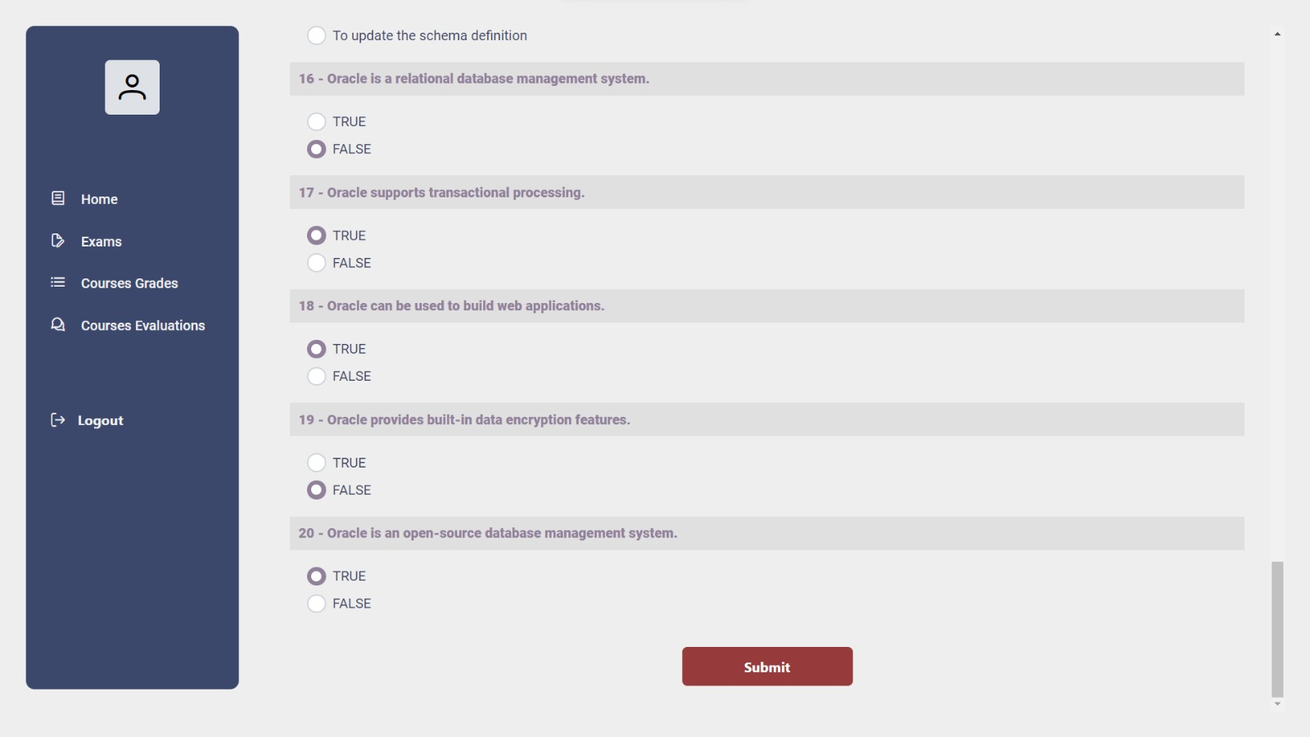

Slide 25
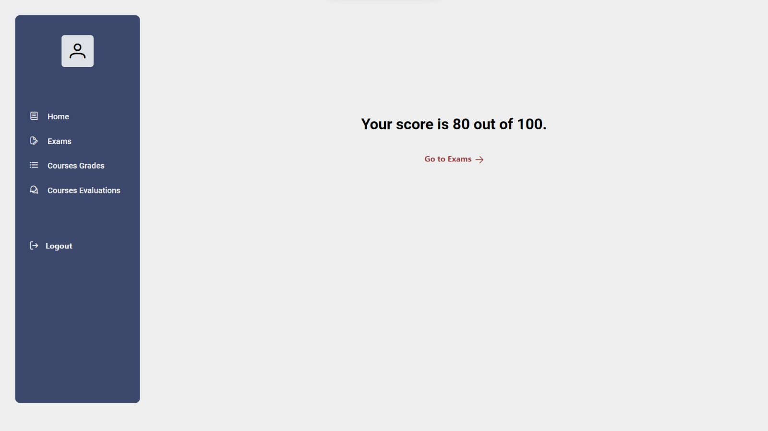

Slide 26
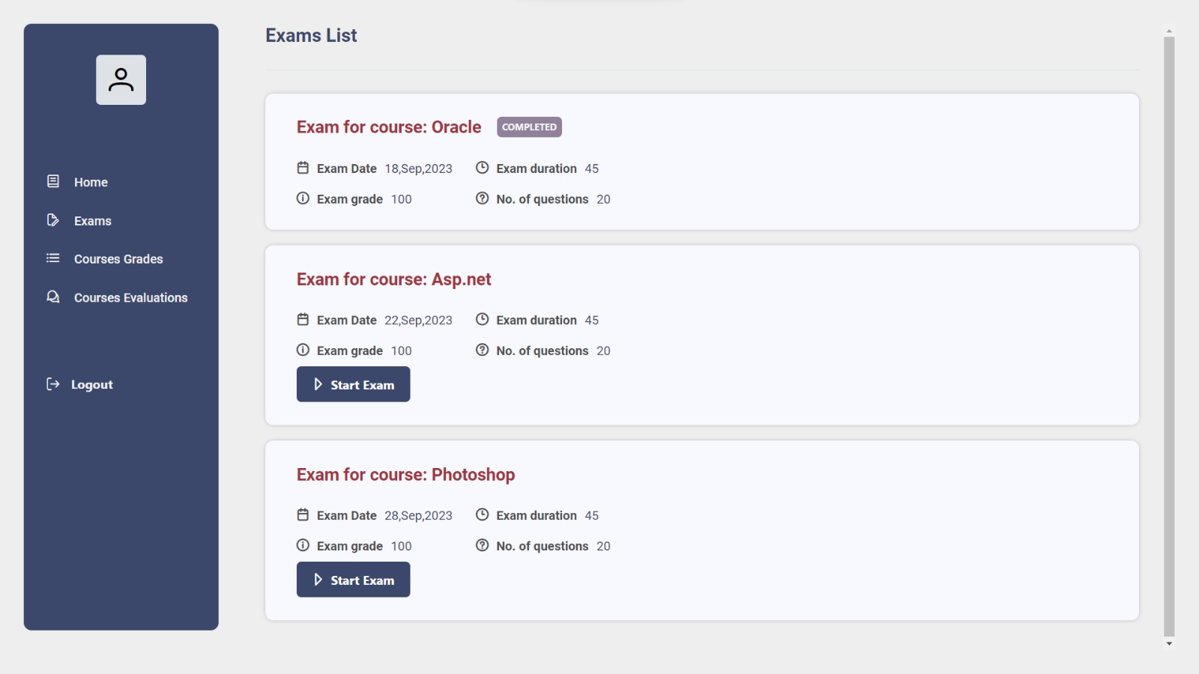

Slide 27
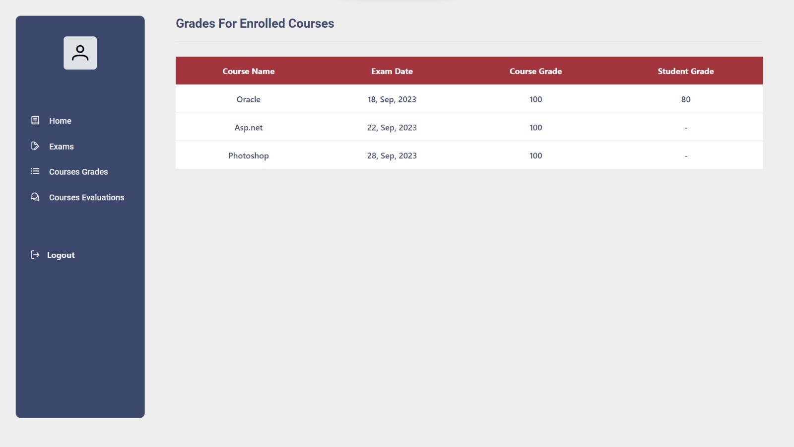

Slide 28
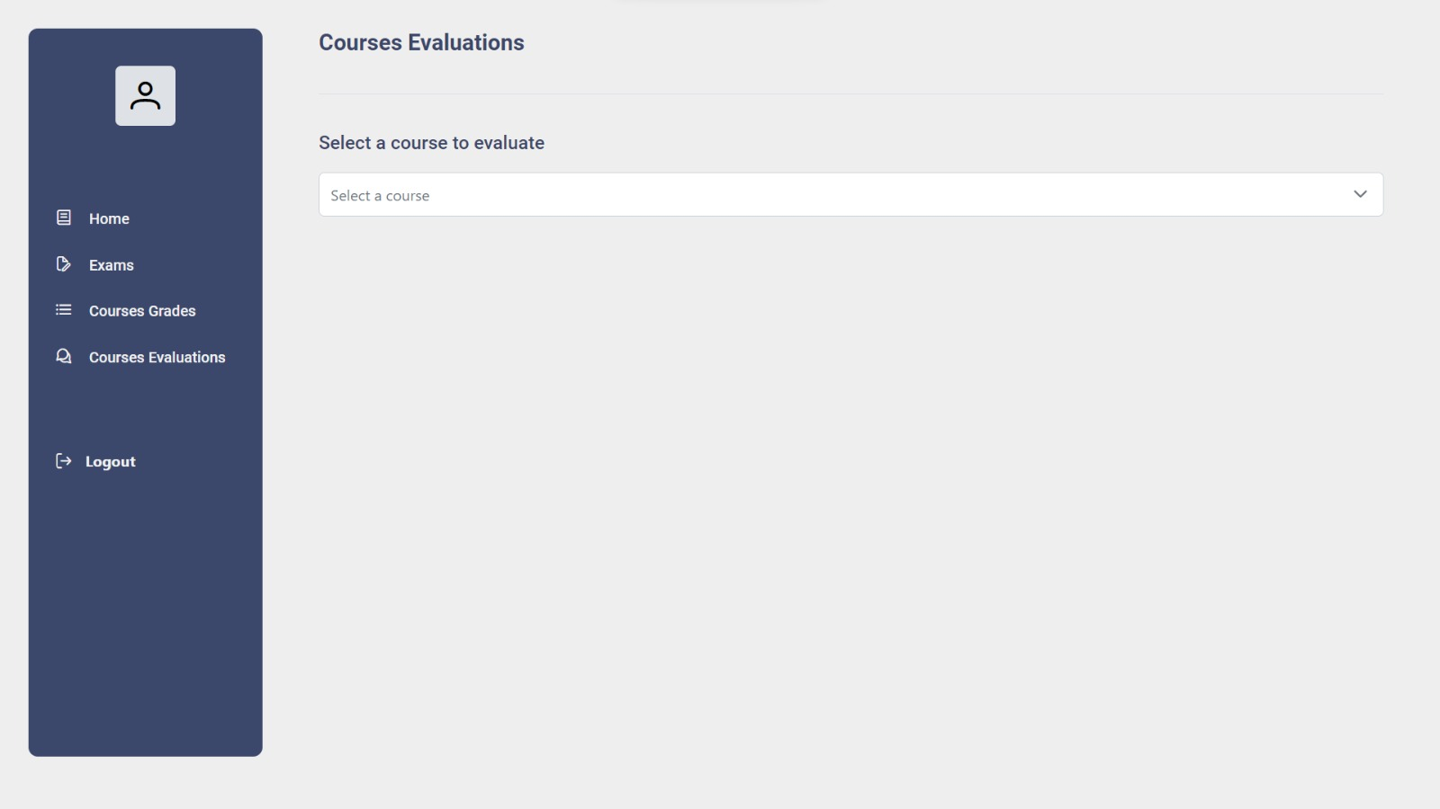

Slide 29
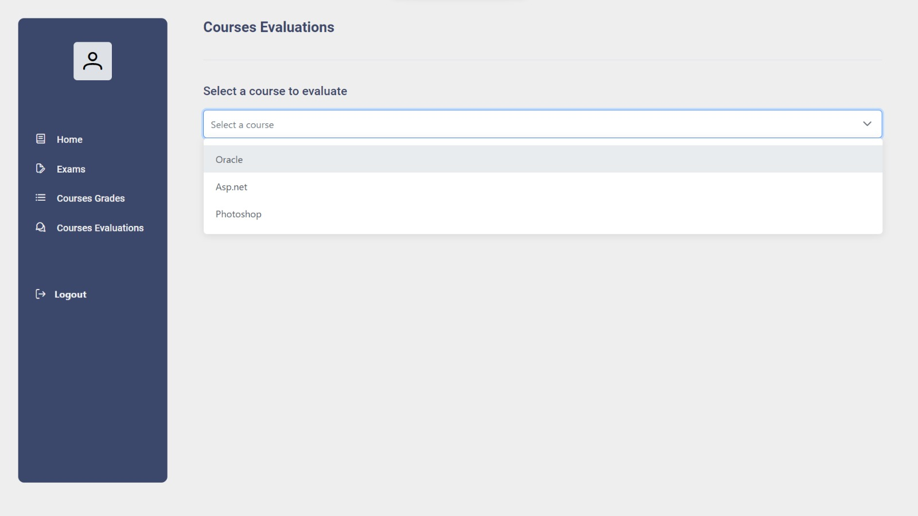

Slide 30
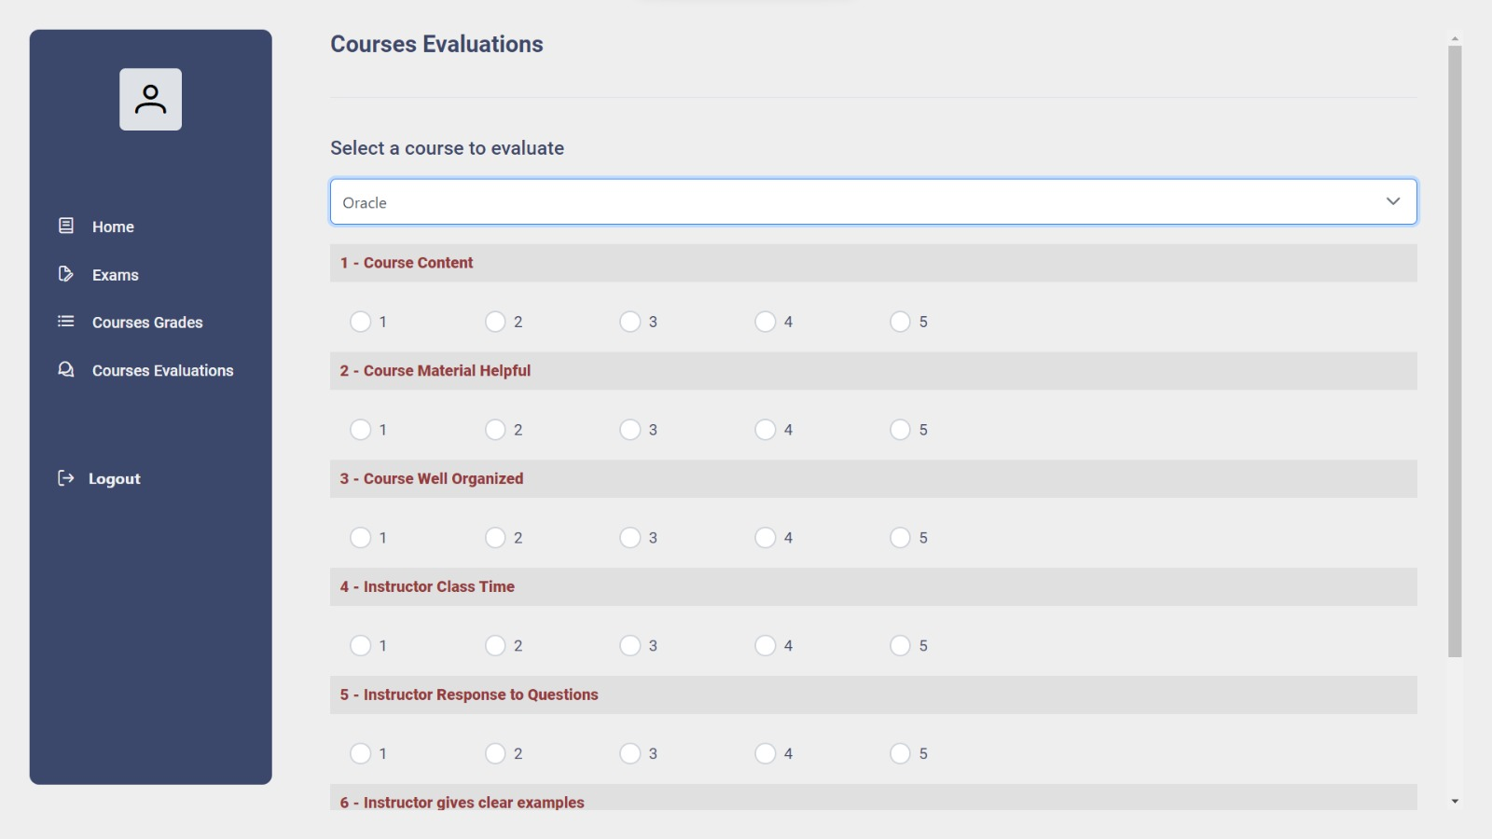

Slide 31
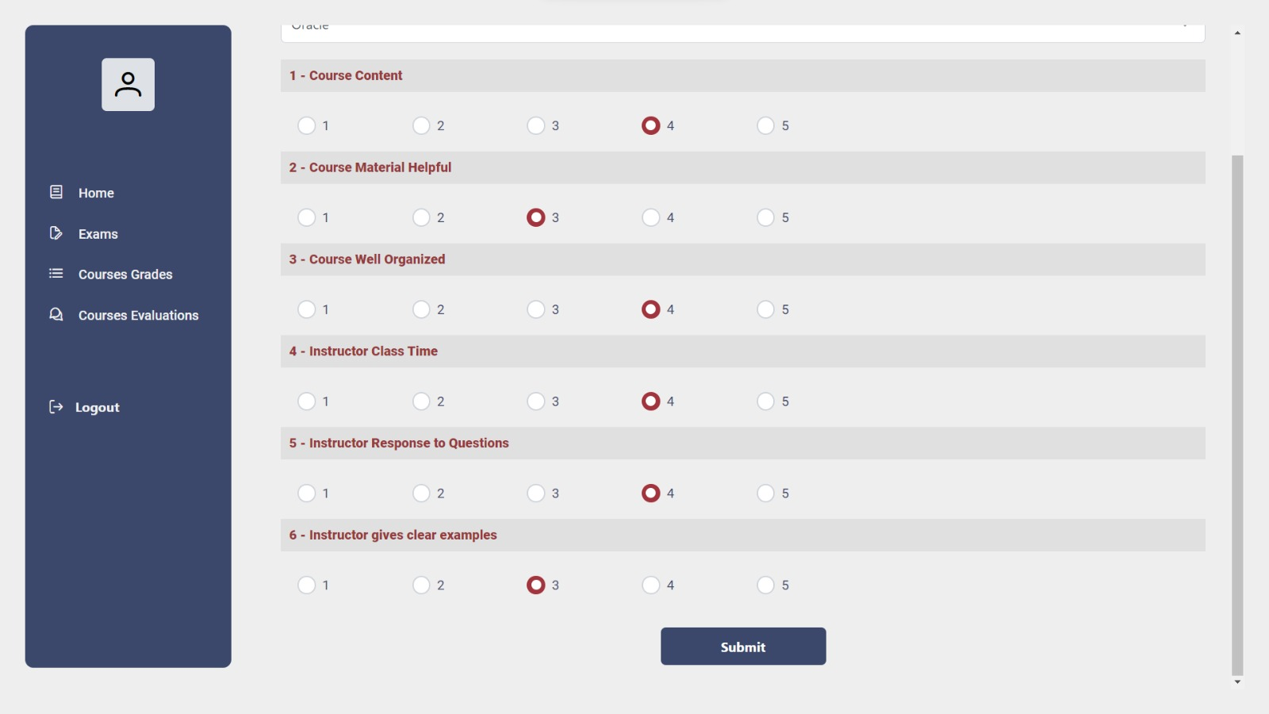

Slide 32
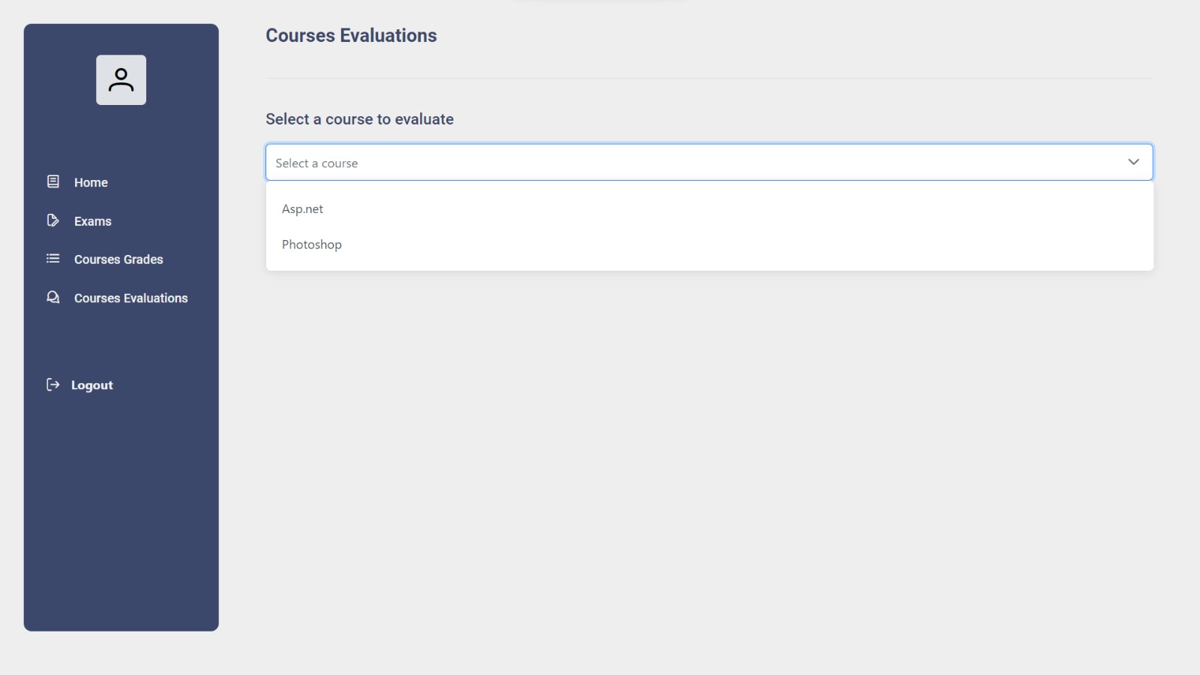

Slide 33

Dashboard

Slide 34

Dashboard

Slide 35


